Slide 1

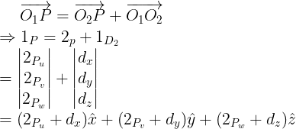

Mapping between frames when they are translated with respect to each other:
w
Given 2_{p} determine, 1_{p}
{2}
P
v
Z
Y
O₂
2_{P}
{1}
2_{P}
v
u
1_{D}
u
2_{P}
2
v
d_{y}
O₁
d_{x}
X
2_{P}
u

Slide 2
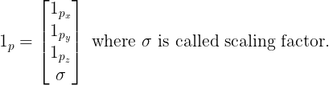
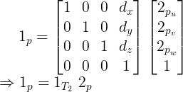
A powerful way of representing translation is in 4-D space of homogeneous coordinates. There a point
P is represented as:
Scaling factor is chosen to be greater than 1 to reduce the objects in the scene and vice versa. For example,
if we use a scaling factor, .5, the object in the scene will look 50% larger than its actual physical dimension.
So, in homogeneous coordinates,

Slide 3
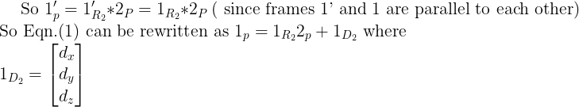


Mapping between rotated and translated frames:
Z’
{1’}
………..(1)
P
w
v
{2}
2_{P}
Y’
1_{P}
u
Here O₁P is 1_{P} and O₂P is 2_{p}. In a vector addition, all the vectors
must be expressed with respect to one frame. So here 2_{P} should be
expressed with respect to frame {1}. To do that a frame 1’ (X’Y’Z’)
is drawn at O₂ whose axes are parallel to the respective axes of frame 1.
Z
O₂
X’
{1}
Y
1_{D}
2
O₁
X
,

Slide 4
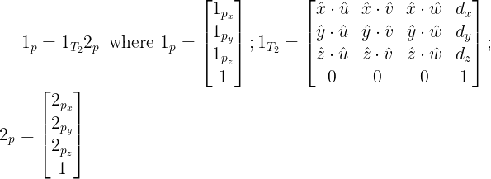
Expressing all the terms in homogenous coordinates,
1_{R} : Rotation matrix
2
1_{D} : Translation vector
2
Perspective Transformation
matrix
Scaling factor

